Slide 1
AUTOMATED INCIDENT ROOT-CAUSE ANALYSIS VIA CLOSE-CODE CLASSIFICATION
Mogili Akhilesh – 202317B3180
GADDAM VENKATA KRISHNA –202317B3143
THARUN A -202317b3045
THADKE LAXMIKANT- DATTATRAY – 202317b3028
TANMAY SHINDE –202317B3053
BITS Pilani WILP

Slide 2
INTRODUCTION
Incident Management
Incident Lifecycle
Process of restoring normal service operation as quickly as possible, minimizing adverse impact on business operations
Incident Detection
↓
Close Codes
Logging & Categorization
Standardized categories indicating the root cause or resolution type of an incident
↓
Root-Cause Analysis
Analysis & Diagnosis
Systematic method to identify underlying causes of problems, enabling preventive measures
↓
Resolution & Recovery
Need for Automation
↓
Enterprise IT systems generate high incident volumes requiring efficient, consistent, and scalable analysis
Close-Code Assignment

Slide 3
PROBLEM STATEMENT & OBJECTIVES
Problem Statement
Objectives
Manual close-code assignment is:
Analyze historical incident logs
Apply NLP on incident descriptions
Time-consuming
Train ML models
Inconsistent
Predict probable close codes
Difficult at enterprise scale
Build recommendation system

Slide 4
DATASET USED
Incident Management Process Enriched Event Log
Class Distribution
Software
35%
UCI Machine Learning Repository
Hardware
25%
Total Records
Features
Network
15%
24,918
36
User Error
10%
Others
15%
Event Log Structure
Incident ID, Timestamp, Priority, Impact, Urgency, Assignment Group, Reassignment Count, Reopen Count, Incident Duration, Description, Close Code
Close Code Categories
Hardware, Software, Network, User Error, Configuration, Database, Security, Authentication

Slide 5
DATA PREPROCESSING
Key Steps
Preprocessing Workflow
Incident Aggregation
Group multiple updates per incident into single record
Raw Incident Logs
Incident Aggregation
Missing Value Handling
Missing Value Handling
Duplicate Removal
Impute or remove incomplete entries
Duplicate Removal
Eliminate redundant incident records
Rare Class Filtering
Dataset Balancing
Rare Class Filtering
Clean Dataset
Remove categories with insufficient samples
Dataset Balancing
Apply techniques to address class imbalance

Slide 6
FEATURE ENGINEERING & NLP
Feature Engineering
NLP Processing
Text Cleaning
Priority
Impact
Lowercase, remove special characters, punctuation
Low / Medium / High
Low / Medium / High
TF-IDF Vectorization
Convert text to numerical feature vectors
Urgency
Reassignment Count
Low / Medium / High
Numerical
Text-to-Vector Workflow
Reopen Count
Incident Duration
Incident Description
Text Cleaning
Numerical
Hours
Tokenization
TF-IDF Vectorization
Structured features derived from incident metadata to complement textual information
Feature Vector

Slide 7
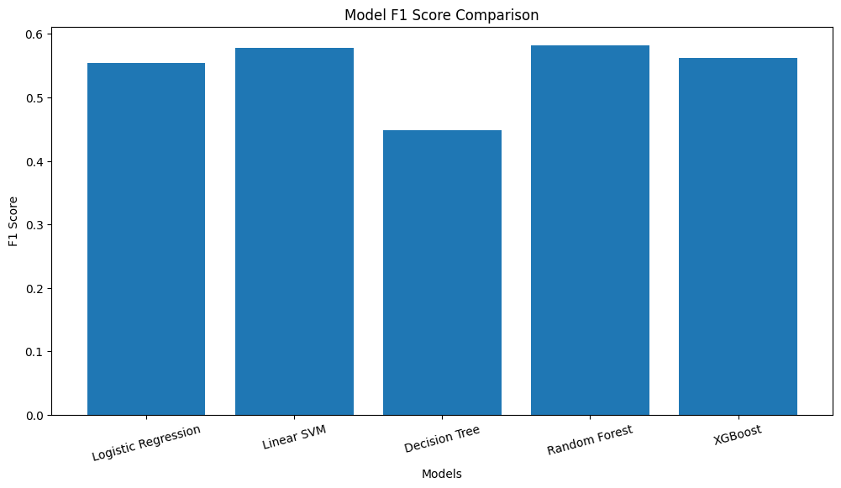
MACHINE LEARNING MODELS
Models Evaluated
Model Comparison
Multiple models compared to identify the best performing algorithm for close-code prediction based on accuracy, precision, recall, and F1-score
Logistic Regression
Linear classification with probabilistic interpretation
Decision Tree
Tree-based model with interpretable rules
Support Vector Machine (SVM)
Optimal hyperplane for classification
Random Forest
Ensemble of decision trees for robust predictions

Slide 8
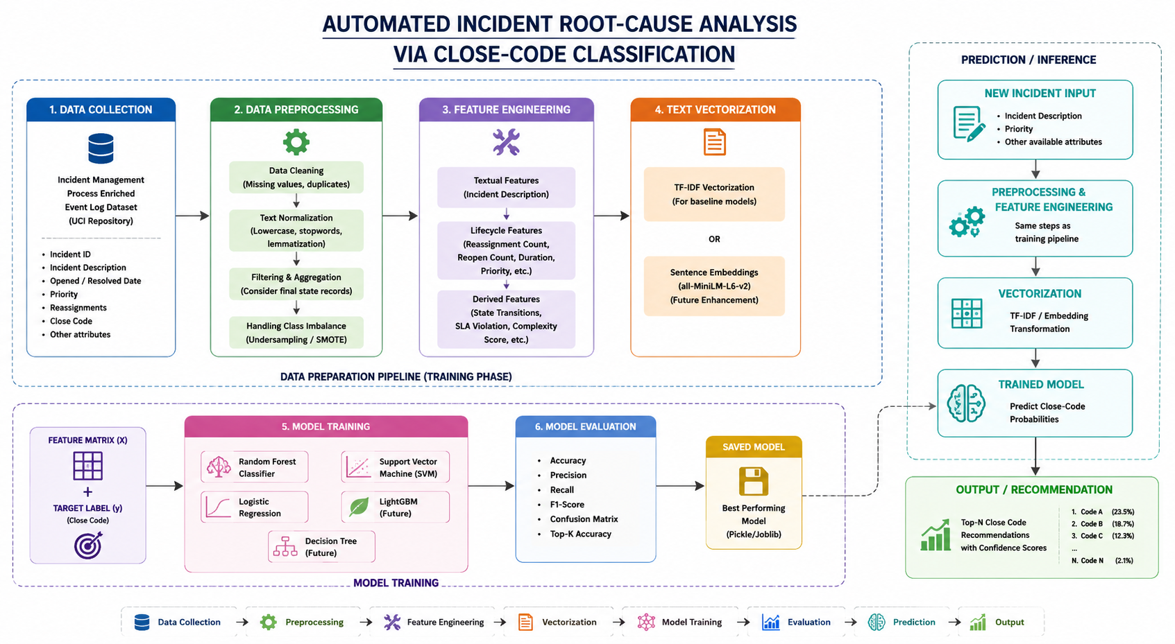
SYSTEM ARCHITECTURE

Slide 9

RESULTS & PERFORMANCE
Performance Metrics
Model Comparison
Accuracy
Precision
~59%
~60%
Best: Random Forest
Across models
Recall
F1-Score
~59%
~52%
Best: Random Forest
Best: Random Forest
Random Forest achieved the best performance among all evaluated models, demonstrating effectiveness in close-code classification
★ Best performing model based on accuracy and F1-score

Slide 10
CHALLENGES FACED
Imbalanced Dataset
Uneven distribution of close-code categories affects model training and evaluation
Classification Ambiguity Example
Incident Description: "Email not working"
Ambiguous Incident Descriptions
Vague or incomplete user reports make accurate classification difficult
Possible Close Codes:
Overlapping Close-Code Categories
Similar incidents may belong to multiple categories, creating classification ambiguity
Network issue
Authentication issue
Sparse Textual Data
SMTP issue
Limited textual features in incident descriptions reduce NLP effectiveness

Slide 11
STREAMLIT DEPLOYMENT
Interface Features
Input Form
Structured data entry for incident attributes
Input Interface
Dropdown Menus
[Screenshot: Incident Input Form with Priority, Impact, Urgency dropdowns and Description text field]
Priority, Impact, Urgency selection
Symptom Description Input
Free-text area for incident details
Recommendation Output
Recommendation Output
[Screenshot: Top-K Close Codes displayed with confidence scores]
Top-K predicted close codes
Confidence Scores
Probability values for each prediction

Slide 12
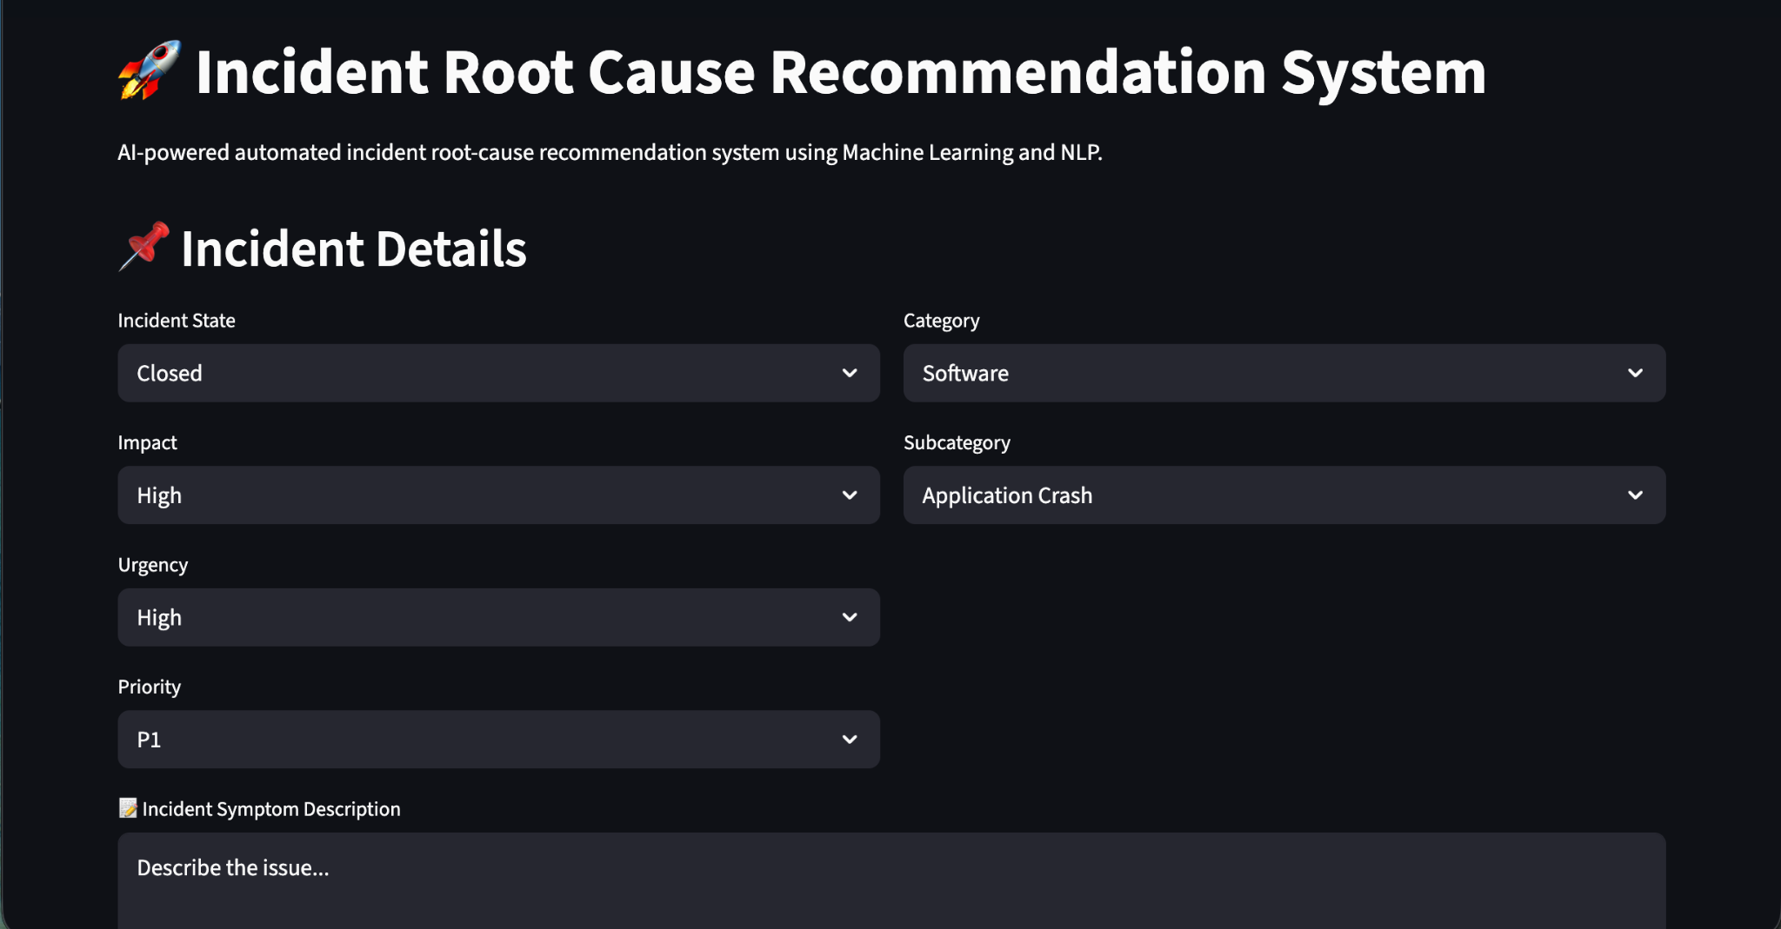
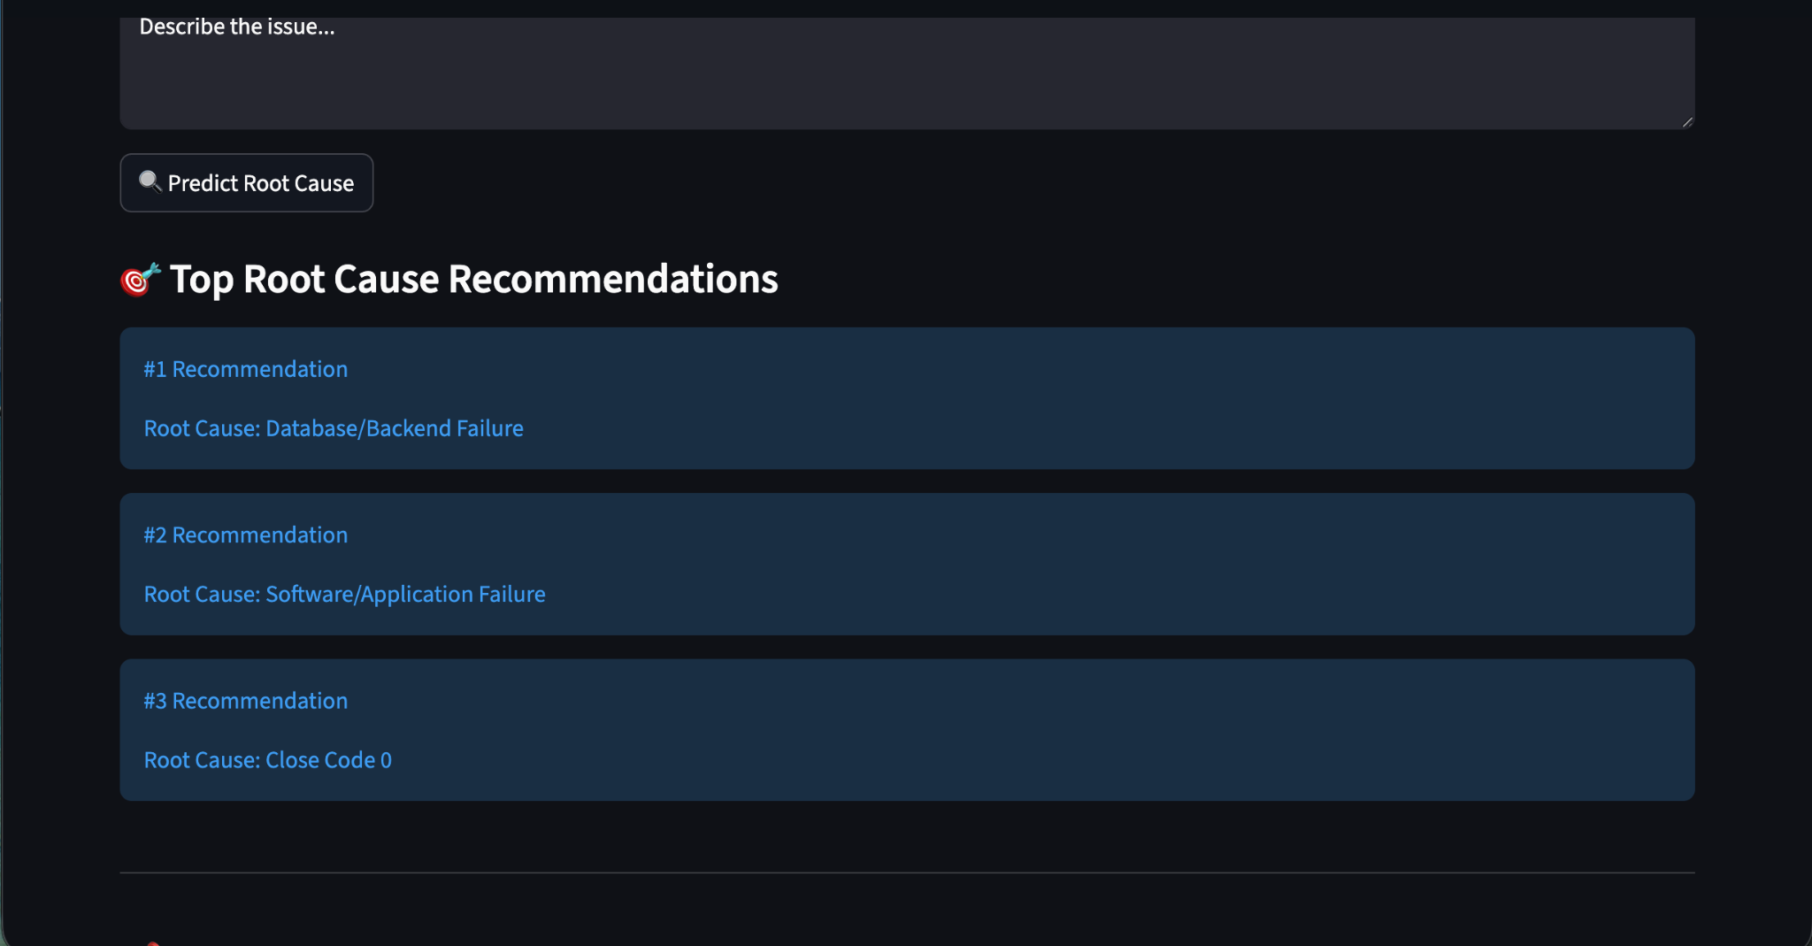

Slide 13
CONCLUSION & FUTURE WORK
Future Work
Conclusion
Implement semantic embeddings for better text representation
Developed ML-based close-code recommendation system
Combined NLP + structured features for enhanced prediction
Explore BERT-based NLP models for improved accuracy
Compared multiple ML algorithms (SVM, Random Forest, etc.)
Develop hierarchical classification for complex incidents
Built interactive deployment interface using Streamlit
Integrate with real-time ITSM systems for live predictions
Achieved ~59% accuracy with Random Forest model
Expand dataset with more diverse incident scenarios

Slide 14
Thank You
Questions and Discussion

